Slide 1


Data Management Plans for Graduate Students
Carol J Wilusz
Colorado State University

Slide 2

Objectives
Introduction to data management plans
Why, when, how to make one
FAIR Principles
Who uses your data / DMP
Go through the components of a DMP and use a template or FAIR Wizard to make your own
Files & Folders
Metadata
Storage & Backup
Sharing & Access
Leave with a draft DMP to share with your supervisor and colleagues
Preservation & Reuse
Responsibilities
Review & Update
Resources

Slide 3
What is a DMP and why do you need one?
Describes data format, organization, access, sharing etc
Ensures you have the necessary equipment and resources at hand
Facilitates consistency within your project and lab
Makes data management and sharing more efficient and effective

Slide 4
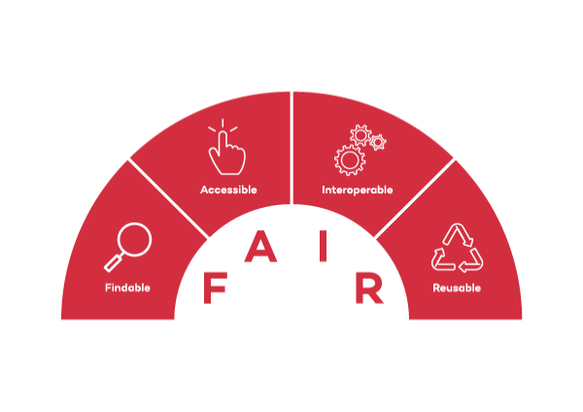
FAIR Principles
How FAIR are your data? Checklist
https://zenodo.org/records/3405141
FAIR Data – Charles University Open Science
https://openscience.cuni.cz/OSCIEN-50.html

Slide 5





Findable
Who needs to find your data?
How and where would they look for it?
How can you make it easier for them?
Post Publication
Pre Publication

Slide 6
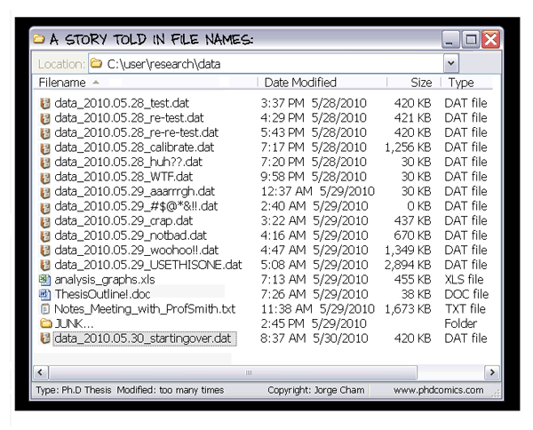
File naming conventions
A good file name allows you to identify the contents WITHOUT opening the file
Allows easy sorting, browsing and retrieval of data

Slide 7

Best Practices in File Naming
Avoid Special Characters and Spaces (not machine readable)
#$^&()+=?\/!@*%{}[]<> X bad!!!
Use _ or – or CamelCase instead of space good!
Think about how you will sort files
Use the international date format YYYYMMDD
Or versions – v01 is better than v1 if you are likely to have many versions
Use abbreviations to avoid long file names
Document the abbreviations! (human readable!)
Each file should have a unique and informative name
Allows you to identify it even if it’s in the wrong place
e.g. Date_Person_Project_Experiment#_DataType
20240107_CJW_U1snRNP_Expt4_qPCR.csv

Slide 8

File Formats
Proprietary / Instrument-Specific Formats
Not accessible for those who don’t have the same instrument/software
Field-Specific Formats
bam, sam, fasta, fastq, gb [genome/transcriptome]
Universal / Common Formats
csv (comma separated values)
tsv (tab separated values)
pdf (portable document format)
tif (tagged image file format)
png (portable network graphic)
txt (text)
rtf (rich text format)
mp4 (movies)
html
rmd (R markdown)
Export or convert your data into a standard format!
Interoperable
https://ukdataservice.ac.uk/learning-hub/research-data-management/format-your-data/recommended-formats/

Slide 9
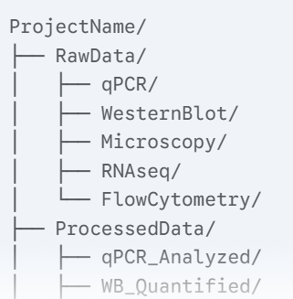
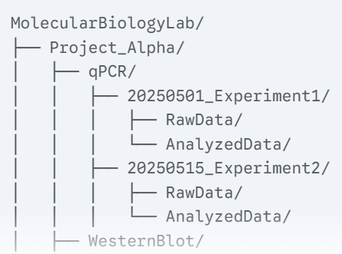

File Organization
Think about how you would search for a piece of data
What are you likely to know about the data?
Use this type of info in your organization
What are you unlikely to know?
DON’T use this type of information in your organization!
https://www.wur.nl/en/value-creation-cooperation/partnerships-collaborations/wdcc-2/research-data-management-wdcc/doing/organising-files-and-folders.htm

Slide 10
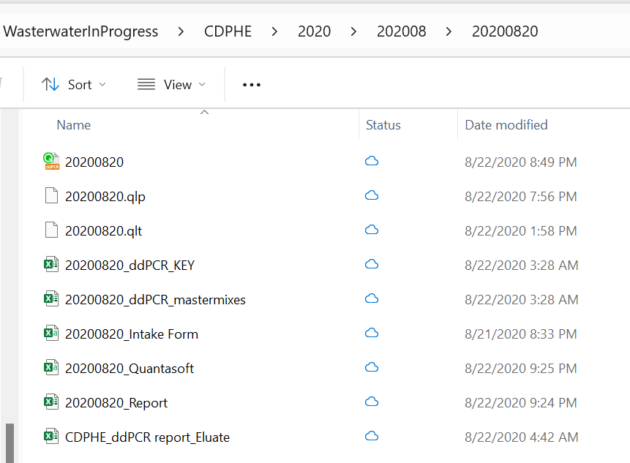

Slide 11
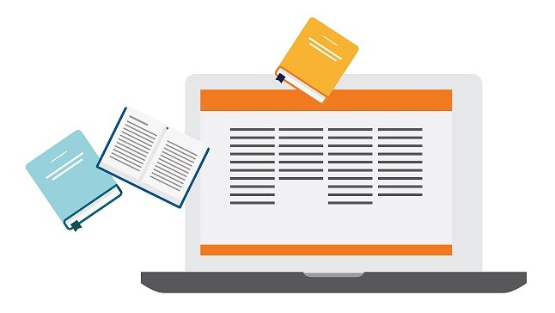
Electronic versus Paper Lab Notebooks
How do you connect the notebook with the data?
Higgins, S.G., Nogiwa-Valdez, A.A. & Stevens, M.M. Considerations for implementing electronic laboratory notebooks in an academic research environment. Nat Protoc 17, 179–189 (2022). https://doi.org/10.1038/s41596-021-00645-8

Slide 12
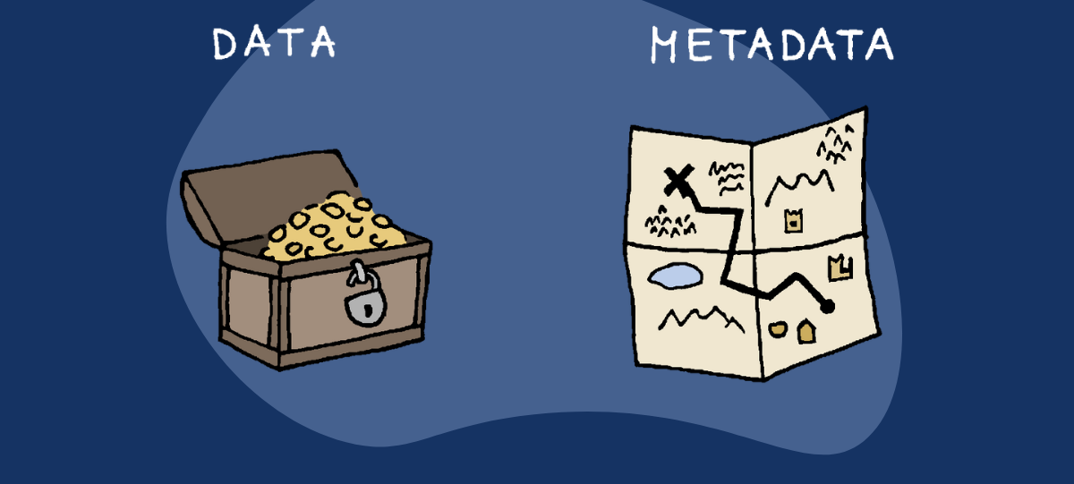
Metadata
Data that describes other data

Slide 13
Common types of metadata
Used standardized / controlled vocabulary
Date
Creator
Instrument
Instrument settings
Software
File Format
Resolution
Sample type
Sample ID
Sample location
Sample treatment
Detection reagent
Detection protocol
Experiment parameters
Study description
Analysis pipeline
Information needed to FIND the data, USE the data or REPLICATE the experiment

Slide 14
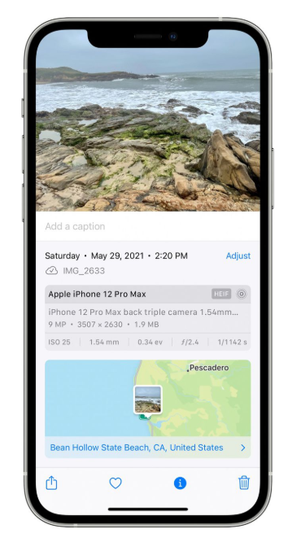
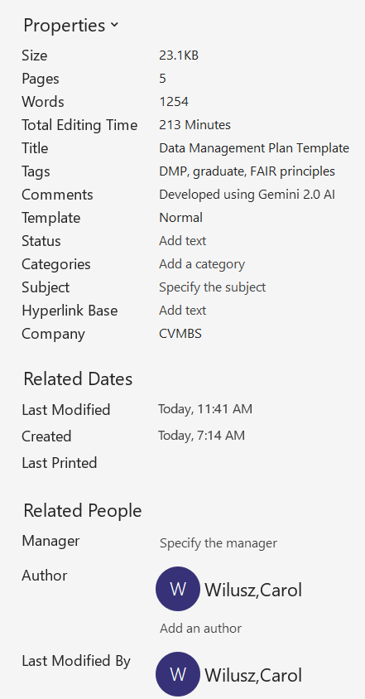

Where can you put the metadata?
In the same folder as the data as a README.txt file
Embedded with the data / file
As part of the entry in a public repository
In your ELN or lab notebook

Slide 15
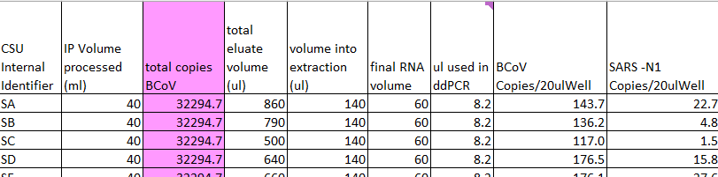
Data Dictionaries
Explain what the data means
Define variables, file names etc
Acceptable values/ranges
Blank values

Slide 16
Filename – YYYYMMDD_report
CSU Internal Identifier – wastewater treatment plant identifier – requires key
IP Volume processed (ml) – Volume of wastewater aspirated through the innovaprep filter in ml
total copies BCoV – copies of BCoV added, calculated based on the # copies detected in the well
total eluate volume (ul) = volume of liquid eluted from the Innovaprep at the ultrafiltration step estimated by pipetting
Etc etc

Slide 17
How do you know what metadata you need?
Minimum information guidelines (e.g. MIQE, MIFlowCyte)
Lab SOPs and Checklists
Journal checklists and templates
Repository requirements
Your DMP!
Macleod et al, The MDAR (Materials Design Analysis Reporting) Framework for transparent reporting in the life sciences, Proc. Natl. Acad. Sci. U.S.A. 118 (17) e2103238118, https://doi.org/10.1073/pnas.2103238118 (2021).

Slide 18
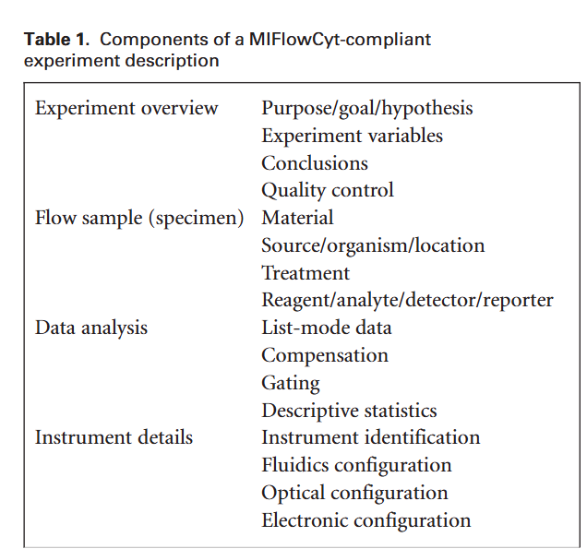
Are there Minimum Information Guidelines for your Experiments?
Lee JA et al. MIFlowCyt: the minimum information about a Flow Cytometry Experiment. Cytometry A. 2008. 73(10):926-30. doi: 10.1002/cyto.a.20623.

Slide 19
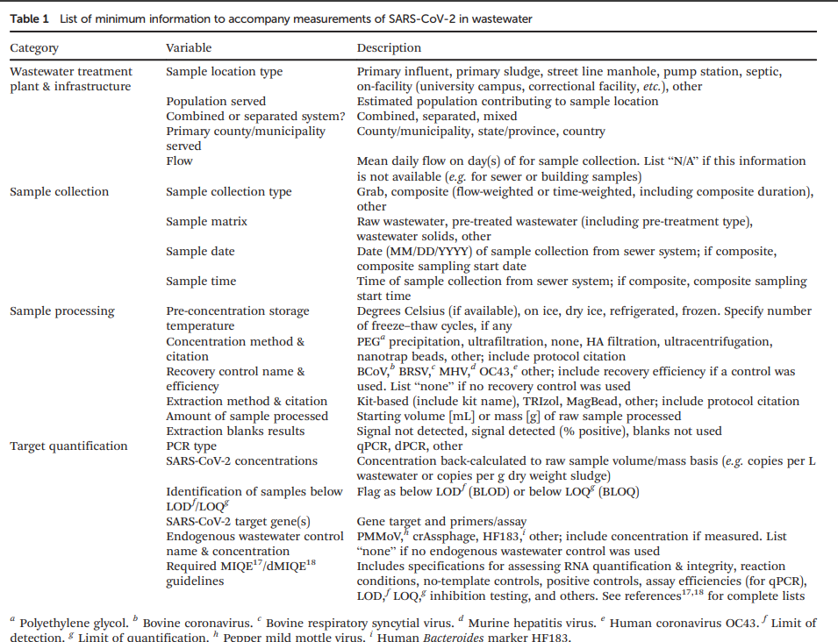
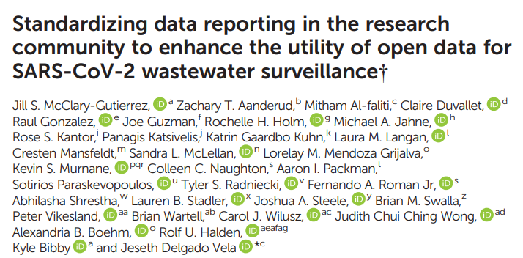

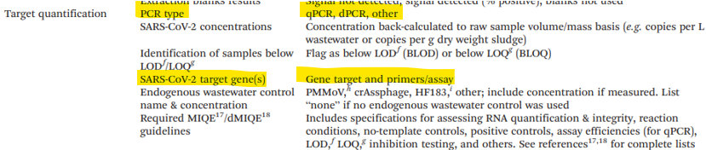

Slide 20
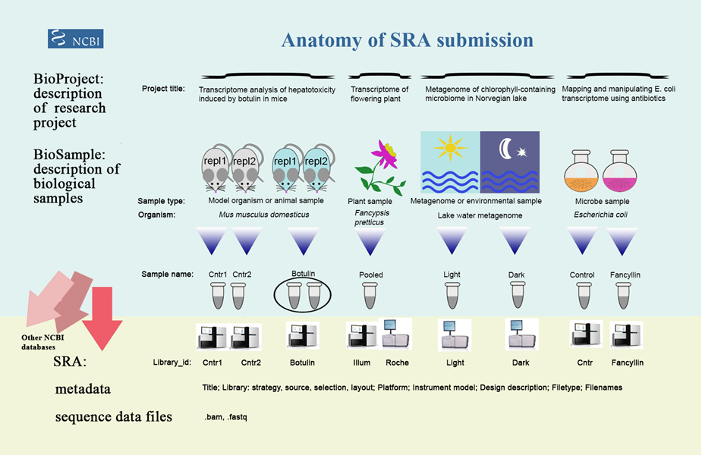

Slide 21

Data Storage & Backup
Consider access, security, cost, and how much data you have
Shared hard drives
CESNET (Czech Data Repository) https://du.cesnet.cz/cs/start
Cloud services (Onedrive, Sharepoint)
Personal vs lab/institute computers

Slide 22



Data Sharing & Access
How will you share data internally, externally?
Who has/needs access?
Data Preservation & Reuse
How long do you need to keep the data for?
Will others want to use it?
Where can you archive it?
Responsibilities
Whose job is it to take care of your data?
Who should approve this plan?
How often should you re-visit the plan?

Slide 23




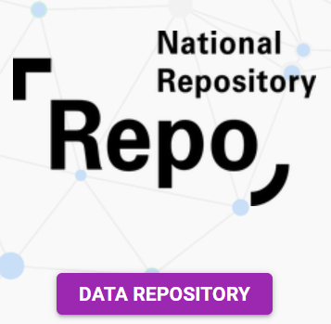

Data Repositories
https://fairsharing.org/
https://www.re3data.org/
https://journals.plos.org/plosbiology/s/recommended-repositories
Look at the requirements before you start your experiment so you can make sure you collect the right metadata
Czech National Infrastructure for Biological Data (ELIXIR CZ) ELIXIR
REPO national repository for Research Data https://du.cesnet.cz/cs/navody/narodni_repozitar/start
Zenodo https://about.zenodo.org/ - independent of field and institution
ELIXIR CZ is dedicated to the organisation, storage, sharing and facilitation of interoperability of life-science data for further processing and analysis.

Slide 24



Resources
Open Science @ CAS
FairWizard (access through CAS)
Czech National Infrastructure for Biological Data (ELIXIR-CZ)
Center for Open Science https://www.cos.io/

Slide 25
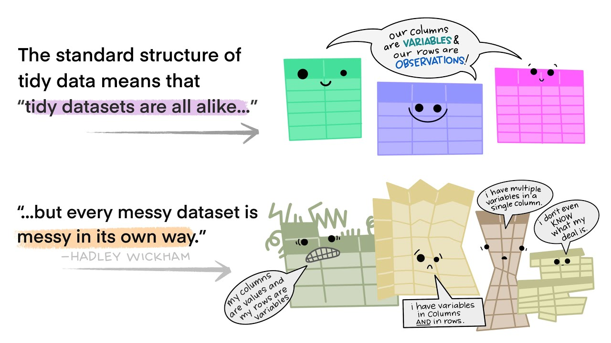
Next time
NEXT TIME - Tuesday May 20 1pm

